Slide 1
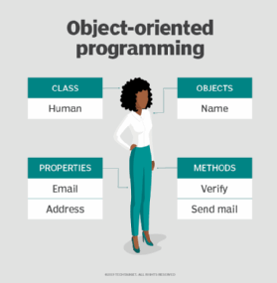
Object Oriented Programming
Object-oriented programming (OOP) is a computer programming model that organizes software design around data, or objects.
This approach is well-suited for programs that are large, complex and actively updated or maintained.
For example, OOP can be used for manufacturing system simulation software.
Programming languages designed primarily for OOP include:
Java
Python
C++

Slide 2

Encapsulation
Describes the idea of bundling data and methods that work on that data within one unit, e.g., a class in Java.

Slide 3
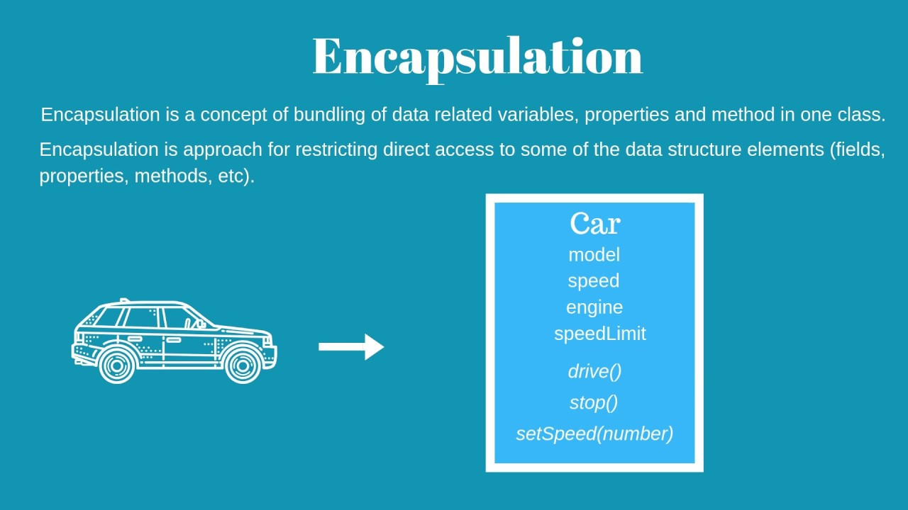
Encapsulation
(continued)
Java supports four access modifiers that you can use to define the visibility of classes, methods, and attributes
Private - This is the most restrictive and most commonly used access modifier.
No modifier - When no modifier specified, for an attribute or method, you can access it within your class and from all classes within the same package.
Protected - Attributes and methods can be accessed within your class, by all classes within the same package, and by all subclasses within the same or other packages.
Public - This is the least restrictive access modifier. Methods and attributes can be accessed within your current class and by all other classes.

Slide 4
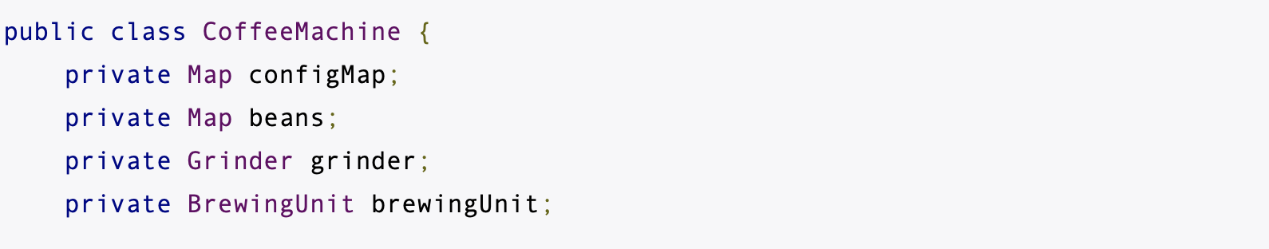
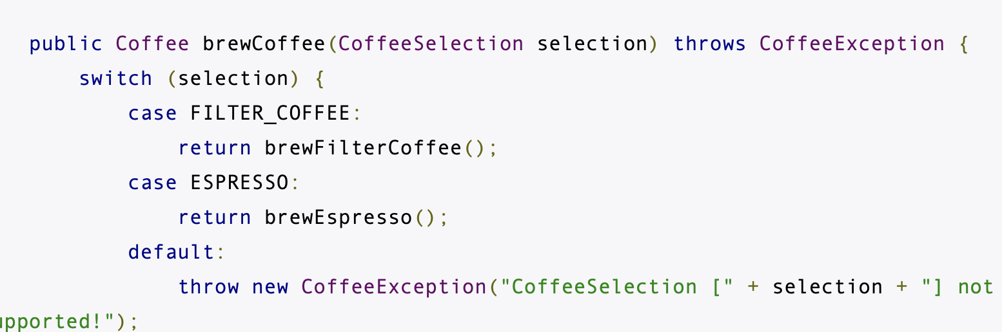
Encapsulation
(continued)
The Coffee Machine example
The attributes configMap, beans, grinder, and brewingUnit store the current state of the CoffeeMachine object.
Information-hiding mechanism is implemented by making class attributes inaccessible from the outside and by providing getter and/or setter methods for attributes that shall be readable or updatable by other classes.
The methods brewCoffee, brewEspresso, brewFilterCoffee and addBeans implement a set of operations on these attributes.

Slide 5
Abstraction
Abstraction is the art of hiding away the unnecessary details. It’s a concept that only shows the relevant features of a function/object to the user and conceals the rest. This allows programmers to make use of the complex programming logic inside and object without having to understand it.

Slide 6

Abstraction
(continued)
Real life-example:
Consider a tv remote:
If a user wanted to change the volume of the tv, he or she would just have to press the + or – on the remote and the volume would change. The user does not need to know how the internal components of the remote interact with the internal components of the tv to change the volume.

Slide 7
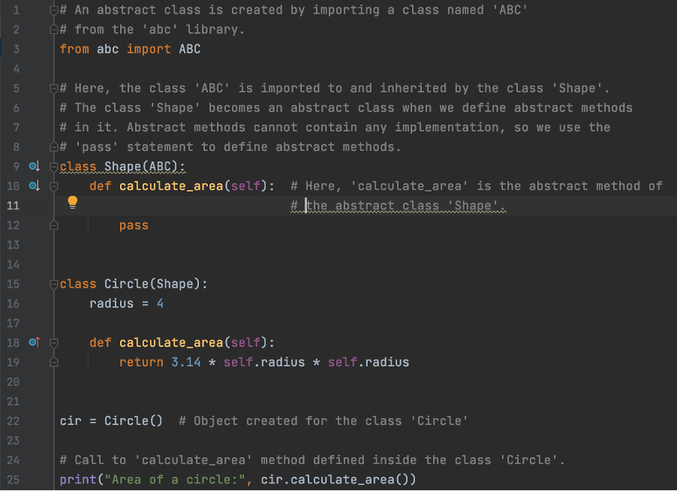
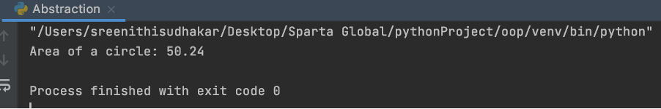
Abstraction
(continued)
Calculating the Area of a Circle
Abstraction in Python:
Can be achieved by using abstract classes and methods.
Abstract methods do not contain any implementation.
Abstract classes cannot be instantiated and require subclasses to provide implementations for the abstract methods.

Slide 8
Abstraction
(continued)
Importance of Abstraction
Allows programmers to create a general idea of what the problem is and how to solve it.
Instructs us to remove all specific detail and any patterns that would not help solve the problems.
Helps us to form an idea of the problem at hand – known as a 'model'
Without abstraction, programmers could end up with the wrong solution to the problem at hand.

Slide 9
Abstraction
(continued)
Advantages of abstraction:
Reduces the complexity of viewing codes.
Increases efficiency.
Avoids code duplicity and increases re-usability.
Helps to increase the security of an application or programme as only important details are provided to the user.

Slide 10
Inheritance
Inheritance allows classes to gain attributes and methods from other classes.

Slide 11
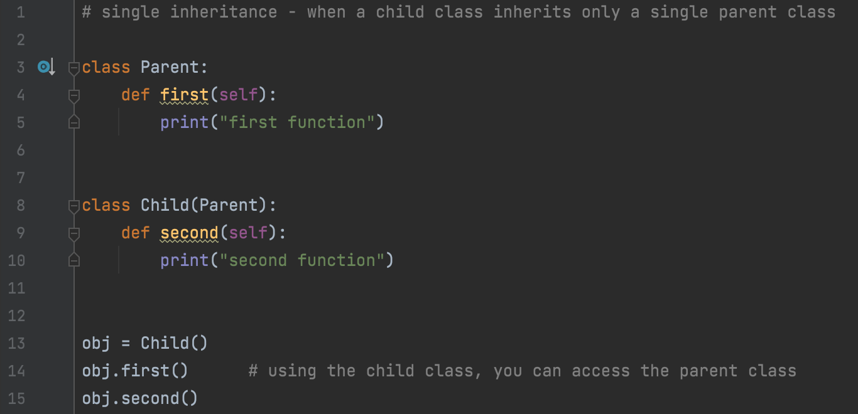

Single inheritance
Single inheritance is when a child class only inherits one parent class.
Output:

Slide 12
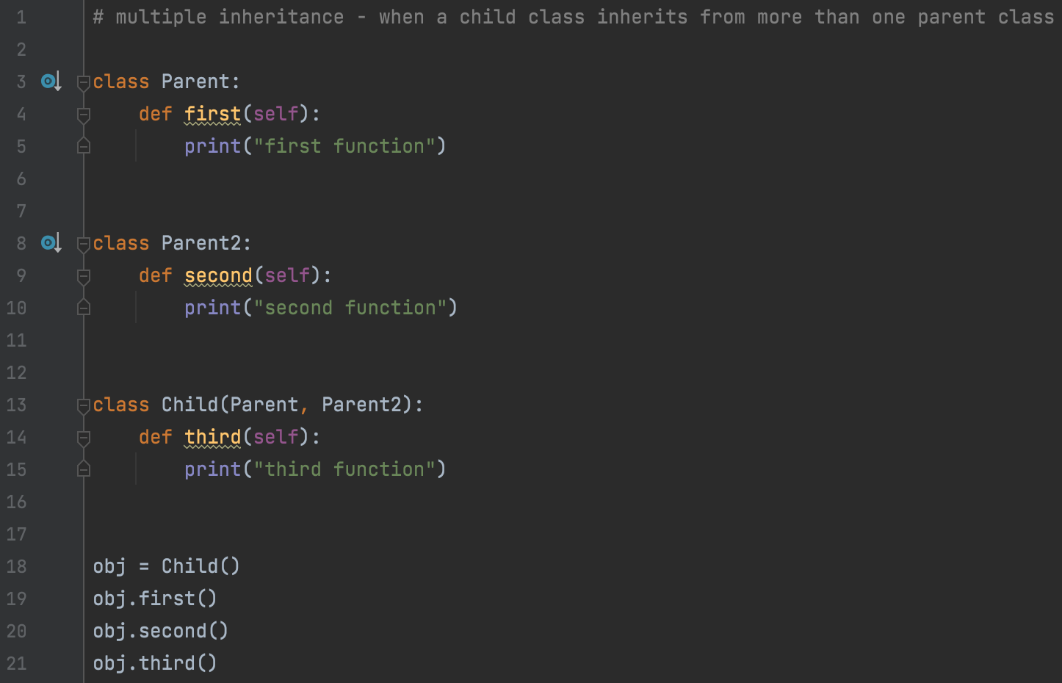
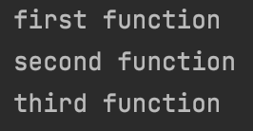
Multiple inheritance
Multiple inheritance is when a chid class inherits from more than one parent class.
Output:

Slide 13
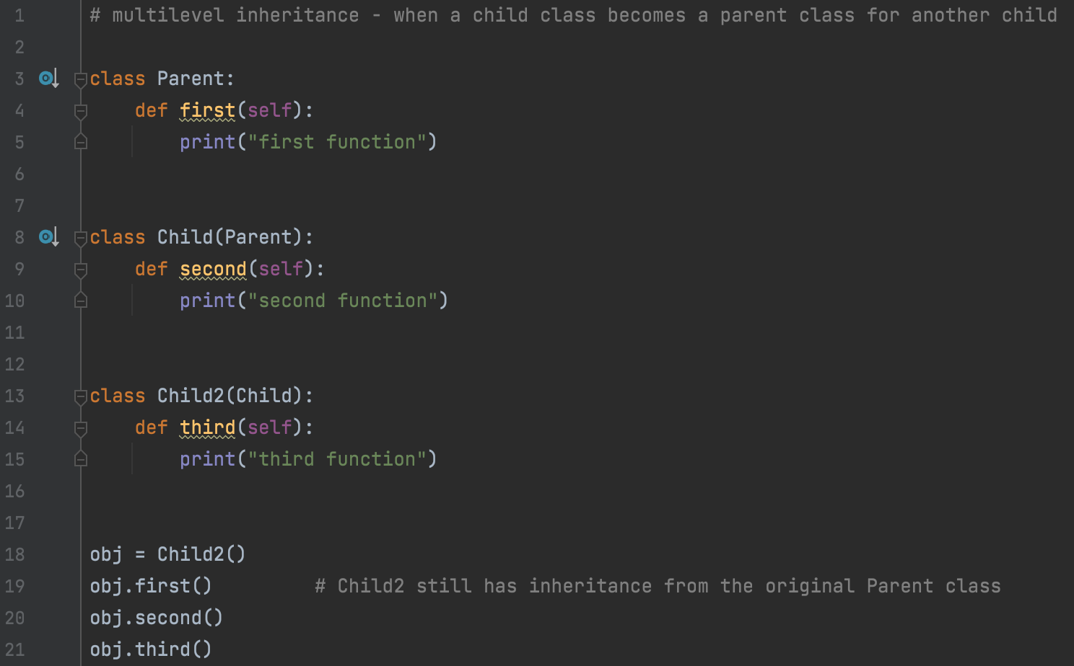
Multi-level Inheritance
Multi-level inheritance is when a child class becomes a parent class for another child
Output:

Slide 14
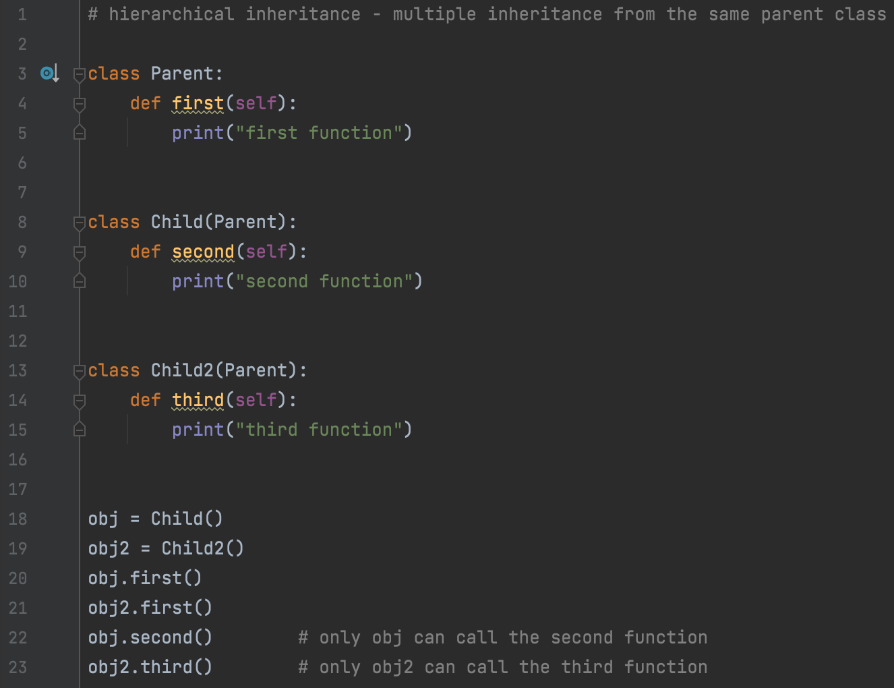
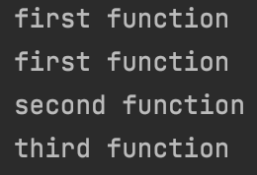
Hierarchical Inheritance
Hierarchical inheritance is when a multiple child classes inherit a single parent class
Output:

Slide 15
Polymorphism
Polymorphism means to have many forms. In programming it is where the same function name (but different arguments) is used for different data types, e.g., int, string, etc.

Slide 16
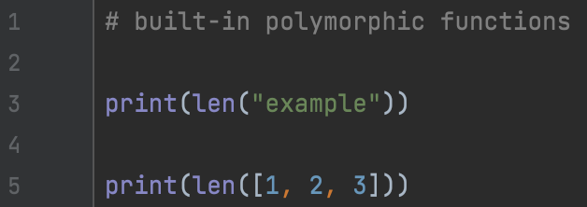

Polymorphism with built-in functions
The built-in length function is polymorphic as it can accept different data types as its argument
Output:

Slide 17
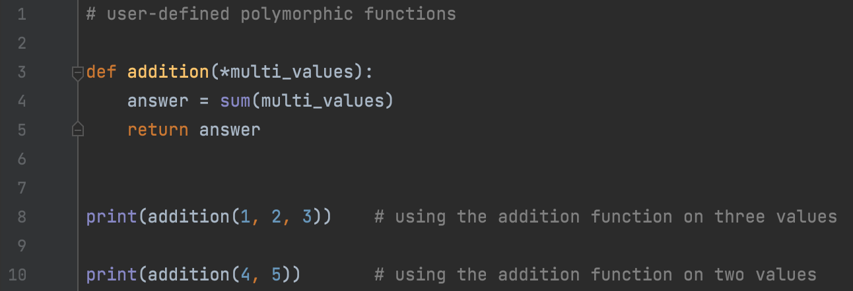

Polymorphism with user-defined functions
A user-defined function that takes many values and returns the sum of those values
Output:

Slide 18
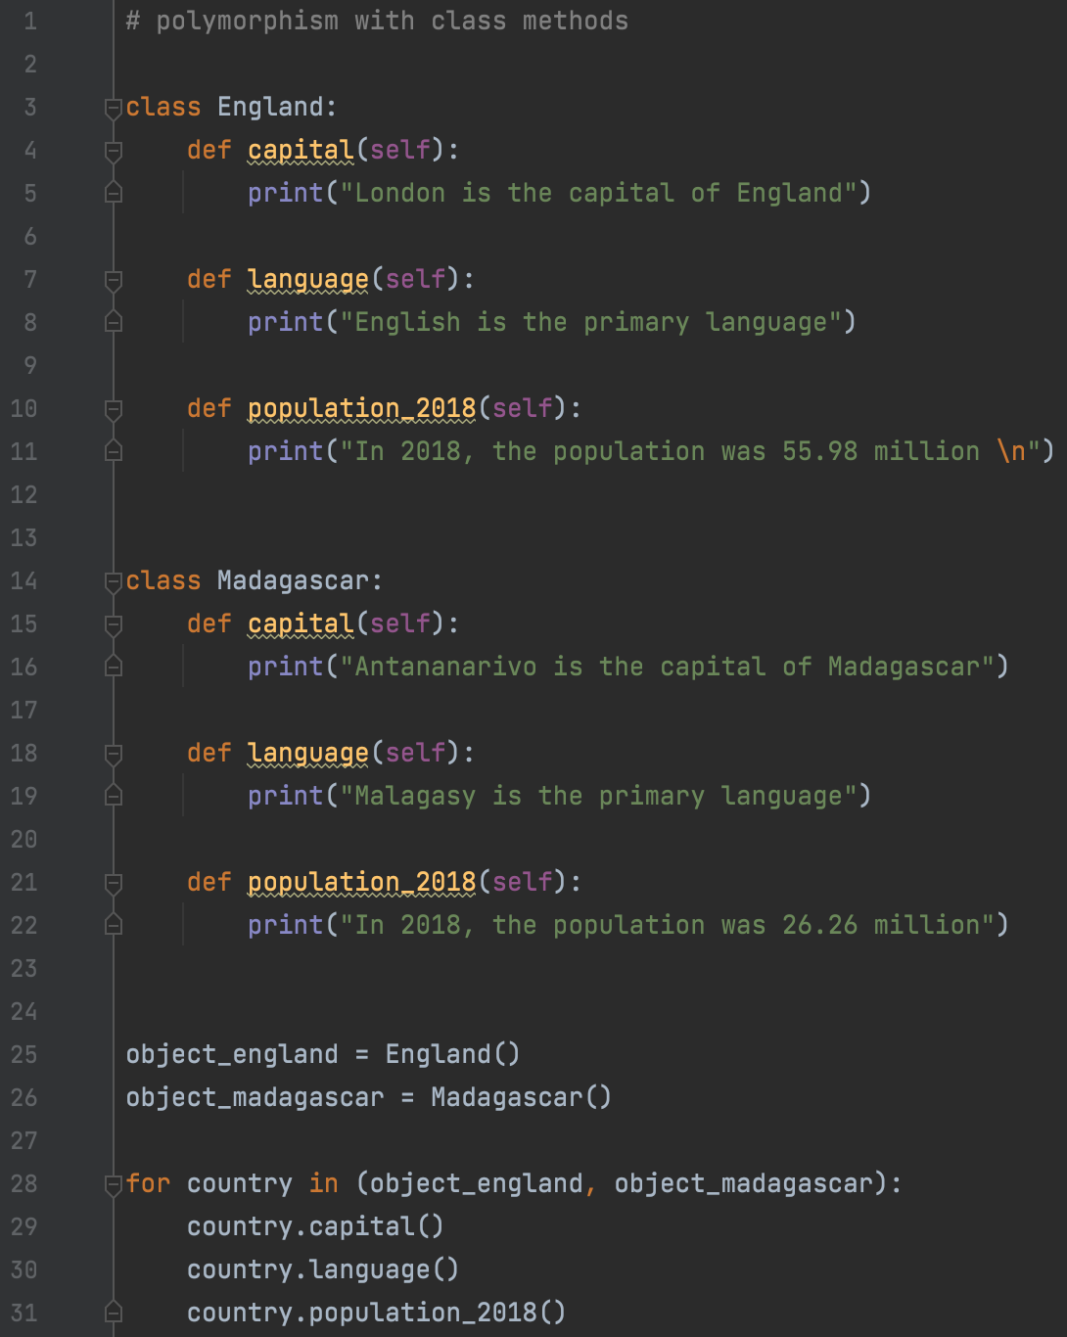
Polymorphism with class methods
Here we have created two separate classes that have the same function names

Slide 19
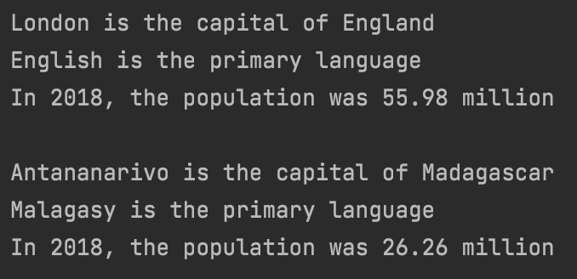
Polymorphism with class methods (continued)
By assigning the classes to two different objects we are able to use the matching functions one
Using a for loop, we iterate through each object calling on the function within the class
Output:

Slide 20
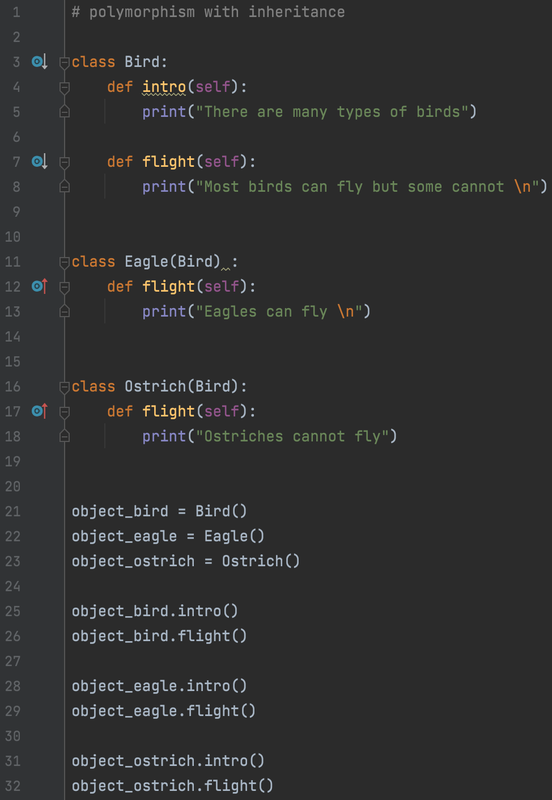
Polymorphism with inheritance
Here we have created three classes
The Bird class is the parent class
Both the Eagle and Ostrich class are children of the Bird class
All three classes have the same flight function but only the parent class contains the intro function

Slide 21
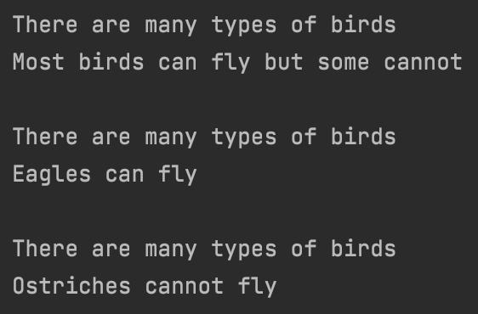
Polymorphism with inheritance (continued)
Each child class, Eagle and Ostrich, has access to the intro function that is in the parent class, Bird
Even though the flight function is the same the input is different depending on the child class
Output:

Slide 22
Summary
The main idea behind OOP is simplicity, code reusability, extendibility, and security.
This is achieved through encapsulation, abstraction, inheritance and polymorphism.
For a language to be classified as OOP, it must have these 4 OOP blocks.
Encapsulation is the process of of keeping classes private so that they cannot be modified by external sources.
Abstraction is the process of displaying the only relevant features to the user and ensures simplicity.
Inheritance has to do with methods and functions inheriting the attributes of another class.
Polymorphism allows the programme code to have many different forms - the same function name can be used for different values (e.g. int, string etc).

Slide 23
Thank You

